Slide 1
Deciphering self-resistance genes in microbial biosynthetic gene clusters to combat AMR
Team Nassar
Resistance is Futile: A codeathon to combat antimicrobial resistance
September 2024

Slide 2
Team Members
Maaly Nassar, Elsevier, Cambridge, UK (Team Leader)
Parul Sharma, Emory University, Atlanta-GA, USA
Dae-young Kim, Children's National Hospital, Washington D.C., USA
Madeline Galac, NIAID BCBB, Washington DC, USA
Brendan Jeffrey, NIAID BCBB, Corvallis, OR, USA

Slide 3
Project Goals
The objective of this project is to create a comprehensive dataset that encompasses self-resistance genes derived from microorganisms known for producing antitumor, antibacterial, and antiviral properties. These genes will be meticulously collected from both scientific publications and existing sequence databases. Utilizing the machine learning framework of Emerald Biosynthetic Gene Clusters (BGCs), we aim to construct a foundational dataset. This dataset will be rich in detail, featuring accession numbers for the self-resistance genes of microbes, the resistant compounds they produce, and the specific biological functions of those compounds.
Deliverables
ML classifier for AMR genes using NCBI pathogen dataset
Self-resistance microbial genes with their related accessions, self-resistance mechanisms, self-resistance compounds and microbes using few-shot LLM prompting and GraphRAG

Slide 4
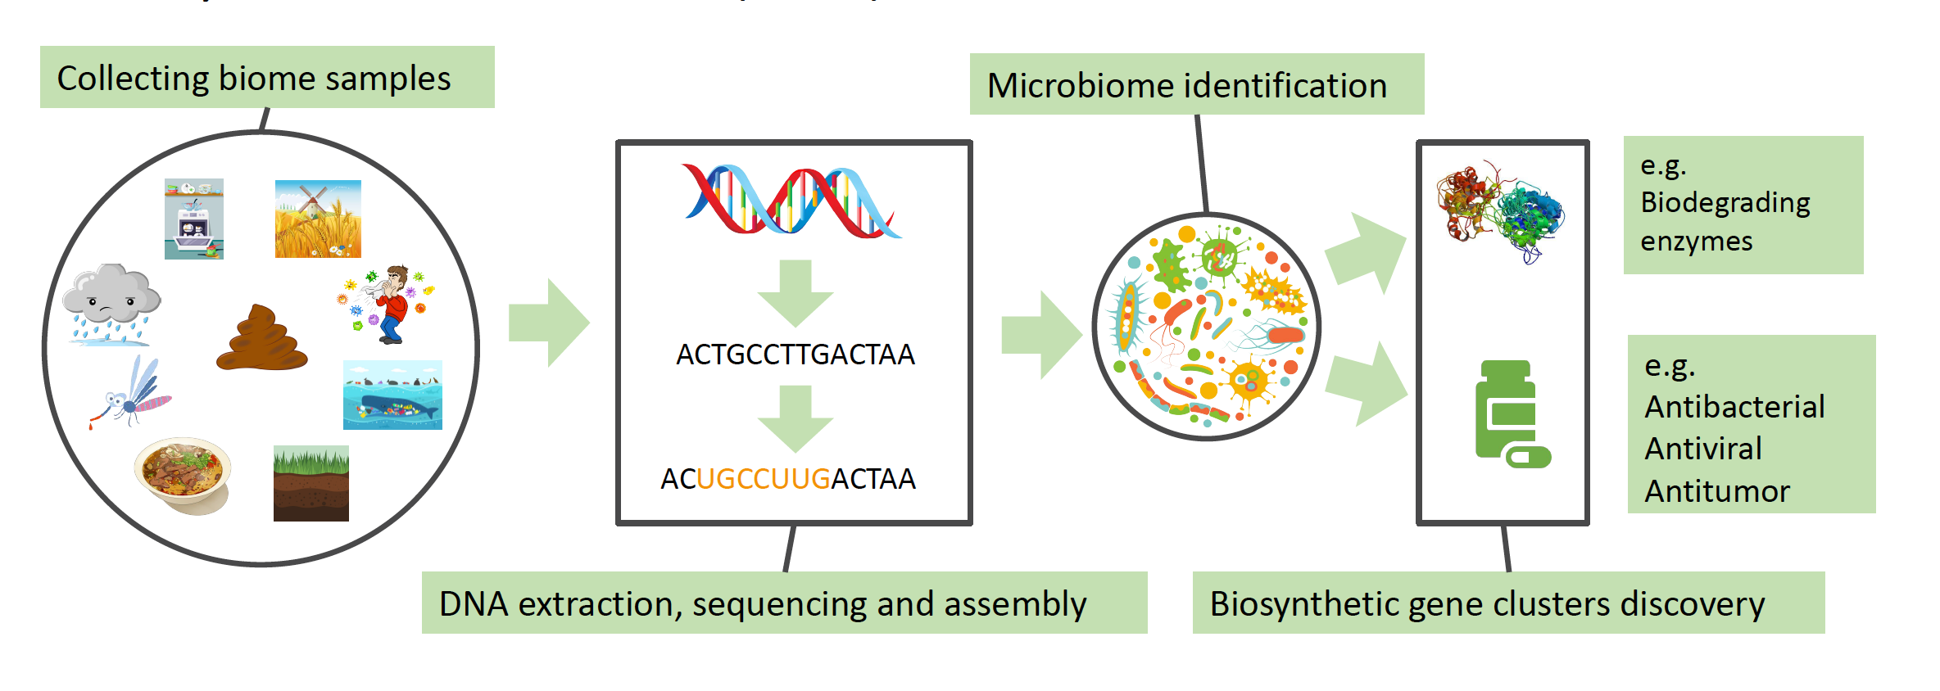
Self-resistance (SR) vs. ANTIMICROBIAL RESISTANCE (AMR)
Self-resistance genes are self protect genes in microorganisms producing antimicrobial, antiviral , antitumor and toxin. They are mostly located in the vicinity of microbial biosynthetic gene clusters (BGCs) and they are up-/downregulated during the biosynthesis process by other genes or environmental factors
Antimicrobial resistance genes (AMR) are innate or acquired genes in microorganisms to resist non-self antimicrobial products (e.g. drugs). They can also be acquired by horizontal transfer from BGCs bacteria or mutation.

Slide 5
Project Objectives
AMR treatments were mostly focused on discovering new antimicrobial drugs (e.g. BGCs by-products) or mutating AMR genes and mechanisms towards losing their function (i.e. loss of function). Thus, the goal of this project is to:
Identify SR genes in antimicrobial-producing microorganisms along with their mechanisms and regulators in literature and corresponding whole genome sequences using Large Language models (LLMs).
Fine-tune machine learning models (e.g. transformers or LLMs) to identify AMR and SR genes in whole genome sequences using NCBI pathogen, isolates , MicroBIGG-E and LLM-derived SR dataset.
Use AMR detection ML model to identify self-resistance genes and SR detection model to identify AMR genes to check for horizontal gene transfer and the possibility of AMR up-/downregulation by SR regulators

Slide 6
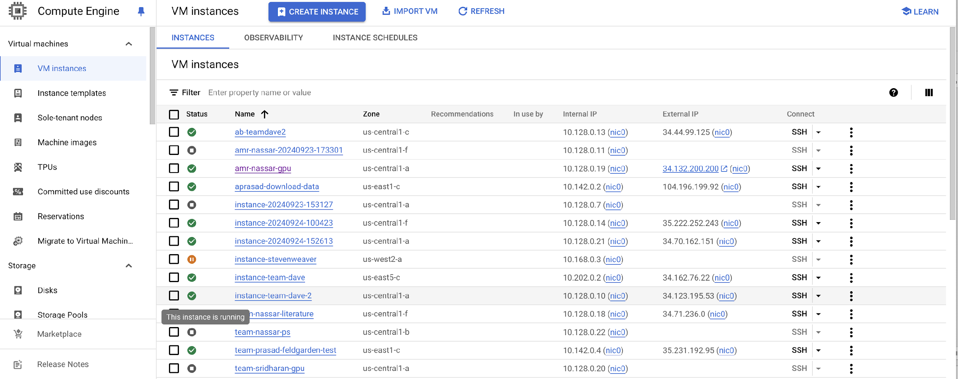
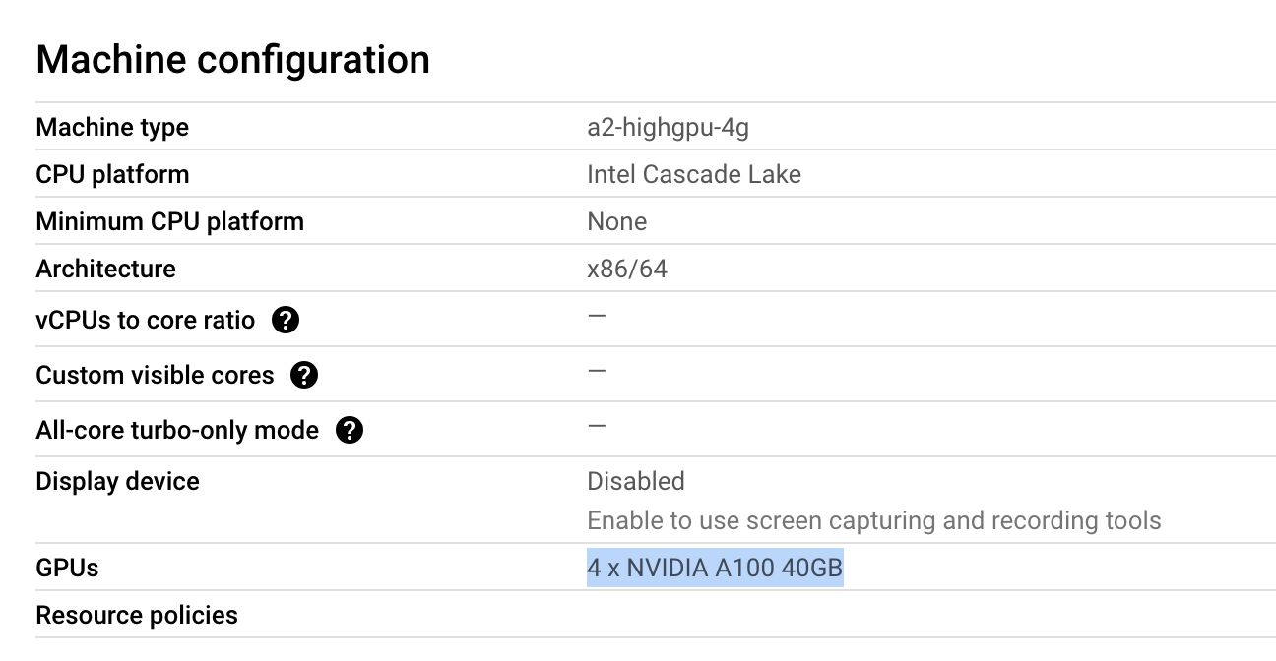
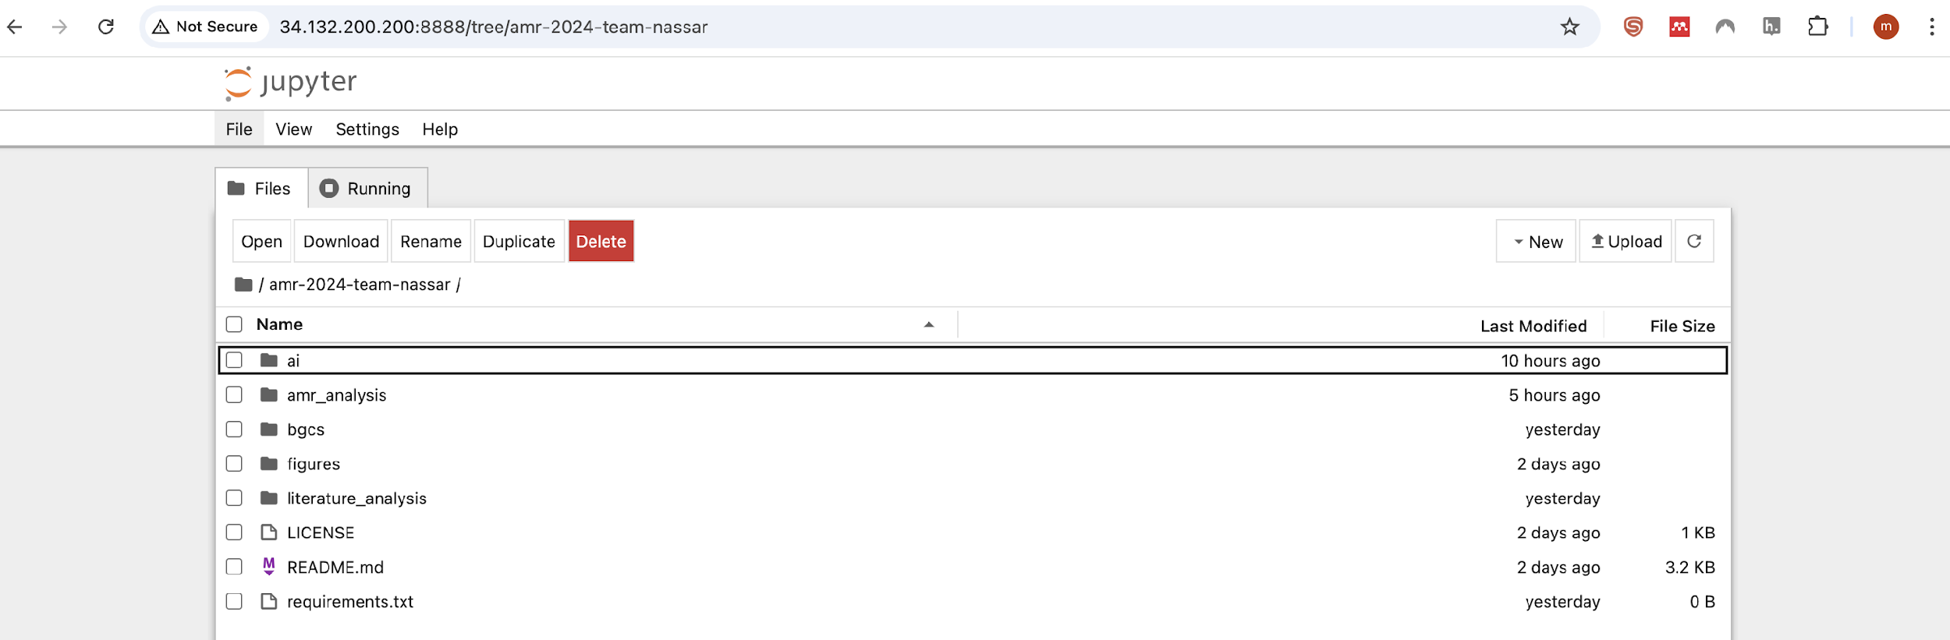
Project Deliverables: Jupyter Notebook Installation on GCP GPU VM (2 days)

Slide 7

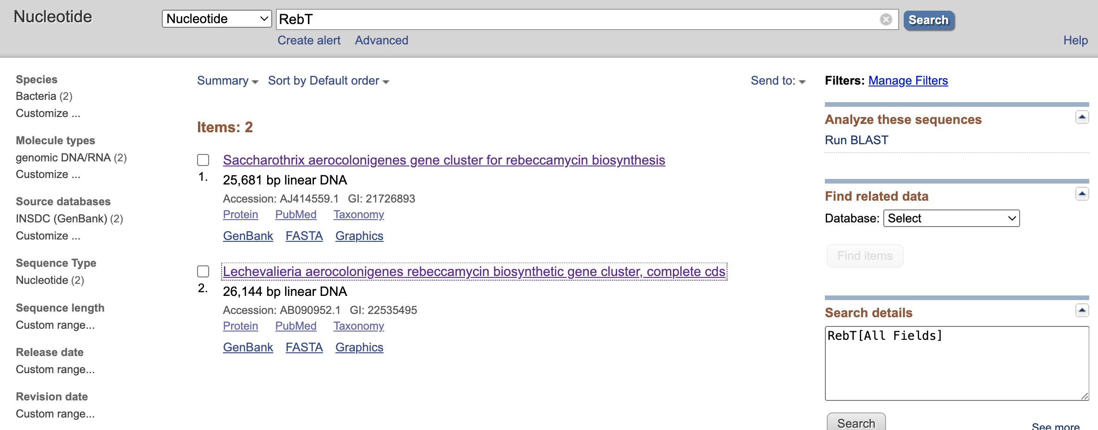



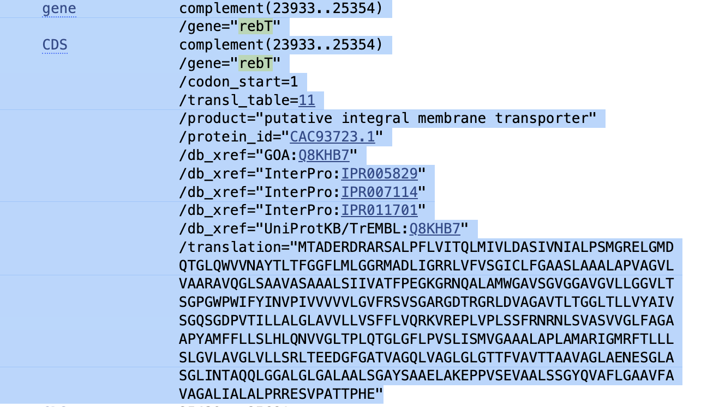

Project Deliverables: SR entity recognition using LLMs (meta-llama/Llama-3.1-70B-Instruct)
Few-shot prompting with llama-3.1-7B-instruct (task + 5 examples)
EMERALD BGCs pipeline (NER transformers)
Annotated sentences with BGCs entities:
bgc-gene-name
bgc-class
bgc-protein-name
bgc-compound
bgc-action
bgc-accession
bgc-organism
Annotated sentences with self-resistance entities:
Self-resistance-gene-protein
Self-resistance-mechanism
Self-resistance-compound
Self-resistance-regulator
Organism
Accession
Self-resistance gene related literature (150 abstracts / 50 OA full texts)
Identifying LLM-derived SR protein translations in whole genome sequences to generate training datasets for fine-tuning SR ML models

Slide 8
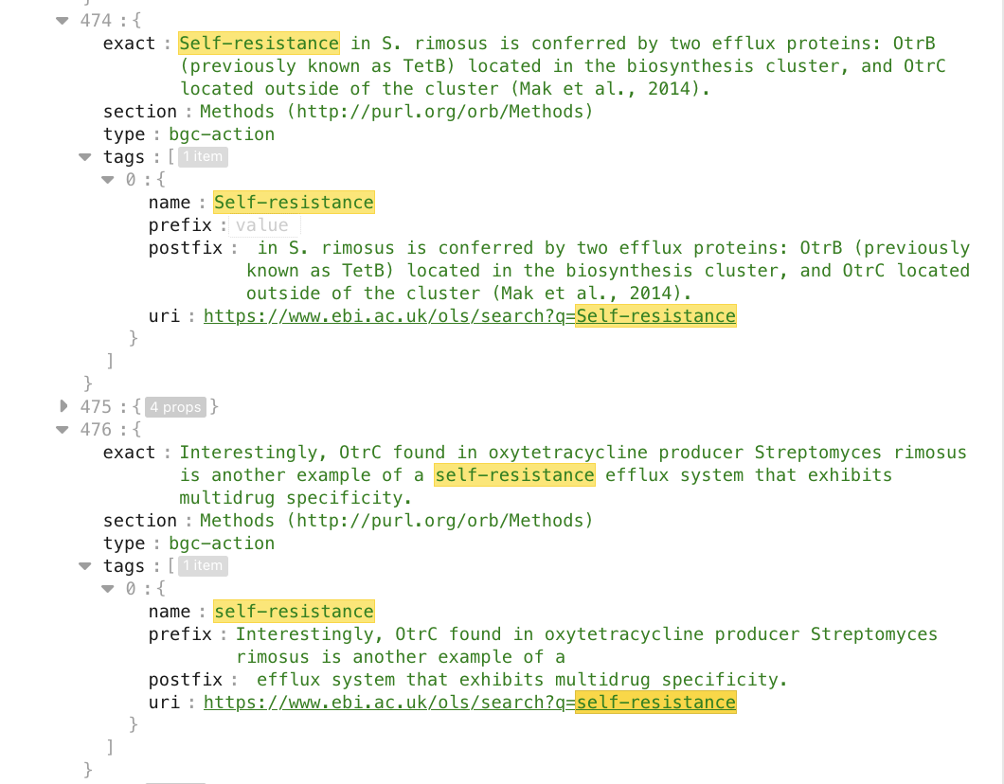
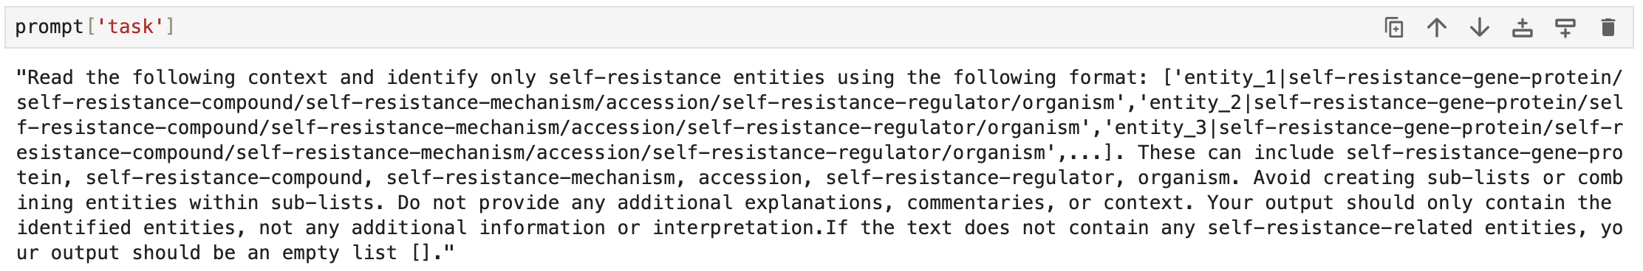
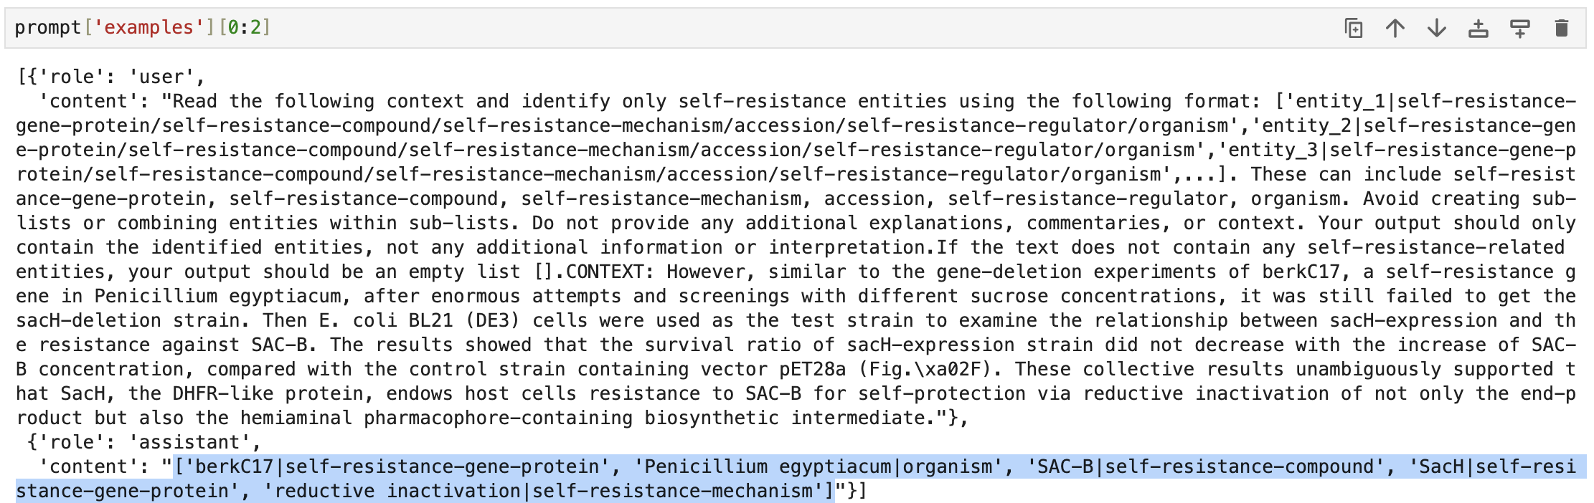
Project Deliverables: SR entity recognition using LLMs (meta-llama/Llama-3.1-70B-Instruct)
EMERALD BGCS NER OUTPUT | LLM TASK, EXAMPLE AND OUTPUT
A putative LysR family protein-encoding gene, lexR, located upstream of lexABC, decreases myxin resistance and production when mutated. ['lexR|self-resistance-gene-protein','myxin|self-resistance-compound']

Slide 9
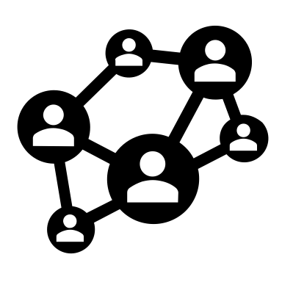
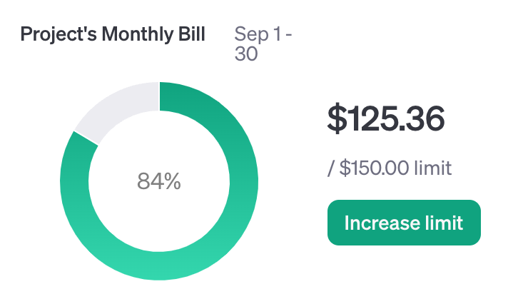
Project Deliverables: SR entity recognition using GrapRAG +GPT-4o
Theme:
self-resistance genes
Few-shot prompting with GraphRAG (task + 3 examples)
Annotated sentences with self-resistance entities:
Self-resistance-gene-protein
Self-resistance-mechanism
Self-resistance-compound
Self-resistance-regulator
Organism
Accession
Self-resistance gene related literature (150 abstracts / 50 OA full texts)
Identifying LLM-derived SR protein translations in whole genome sequences to generate training datasets for fine-tuning SR ML models
Notes:
Hi, my name is Dae-young Kim, and I will take over the presentation from now on :)
In addition to the topics covered in the previous slides, we also trained the GraphRAG model developed by Microsoft with GPT-4o as a backend engine.
Long story short, it creates graphs with the identified entities and their relationship within the input text.
We’ve got 150 self-resistance gene literatures, which we fed to the graph rag and told it that those are about “self-resistance.”
Our purpose was to get Self-resistance-gene-protein, mechanism, compound, regulator, Organism, and Accession from the literature.

Slide 10
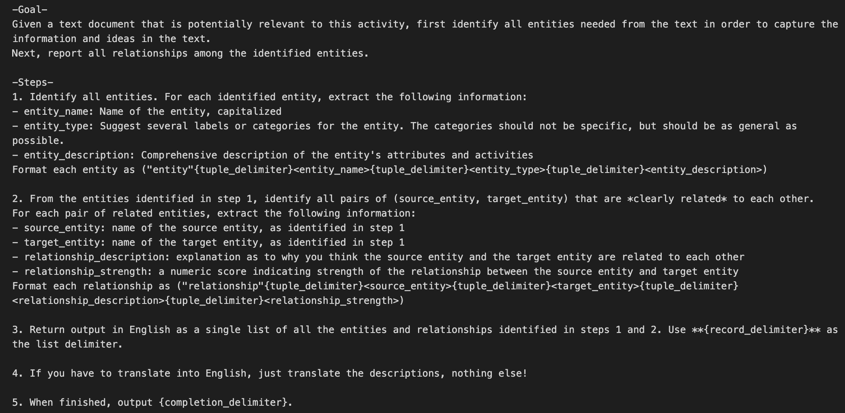
Project Deliverables: GrapRAG +GPT-4o Prompt
Notes:
We also told GraphRAG to create a training prompt for us, and here are the instructions it made.
The instruction tells GPT-4o to find all the entities and relationships between them with descriptions.

Slide 11
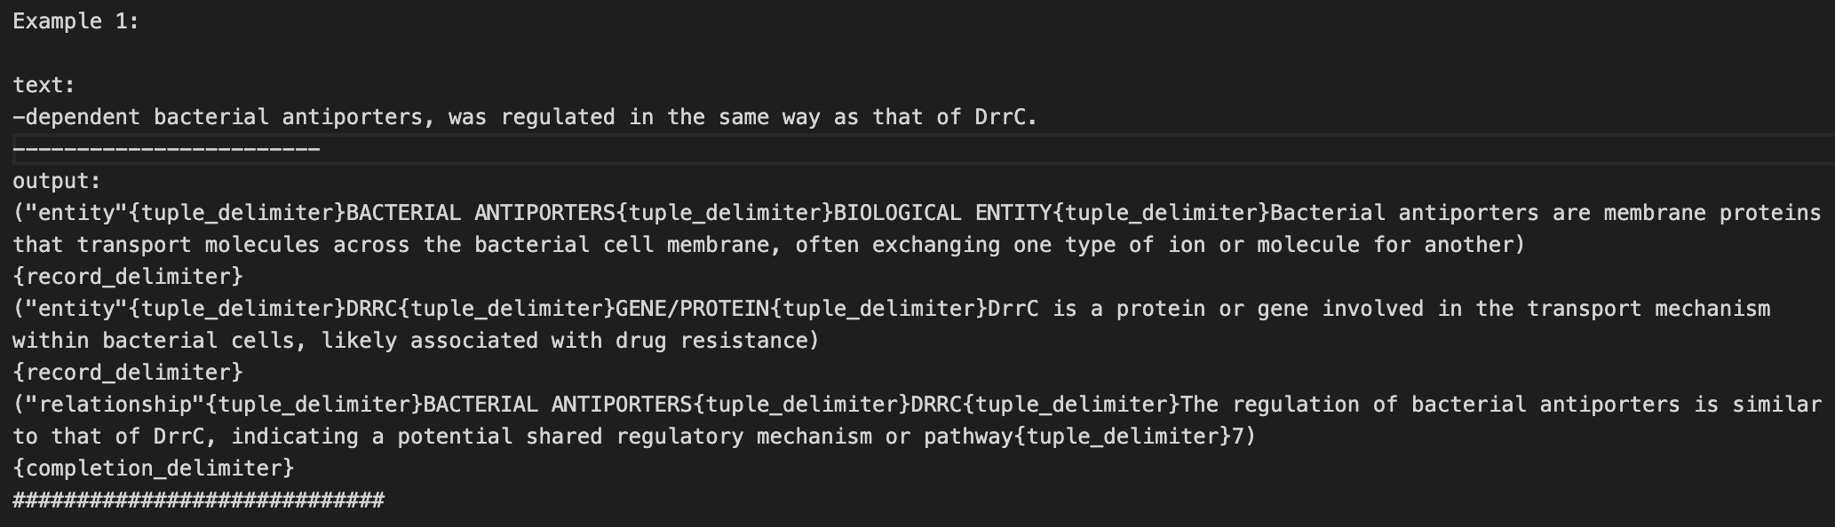
Project Deliverables: GrapRAG +GPT-4o Example by GPT-4o
Notes:
It also made three examples for a few shot examples. Like this.

Slide 12
Project Deliverables: GrapRAG +GPT-4o Example by GPT-4o
text:
-dependent bacterial antiporters, was regulated in the same way as that of DrrC.
------------------------
output:
BACTERIAL ANTIPORTERS are a BIOLOGICAL ENTITY because Bacterial antiporters are membrane proteins that transport molecules across the bacterial cell membrane, often exchanging one type of ion or molecule for another)
DRRC is a GENE/PROTEIN because DrrC is a protein or gene involved in the transport mechanism within bacterial cells, likely associated with drug resistance
BACTERIAL ANTIPORTERS and DRRC have relationship because The regulation of bacterial antiporters is similar to that of DrrC, indicating a potential shared regulatory mechanism or pathway
Notes:
I made it easier for human readers like us. Does this example make sense?

Slide 13
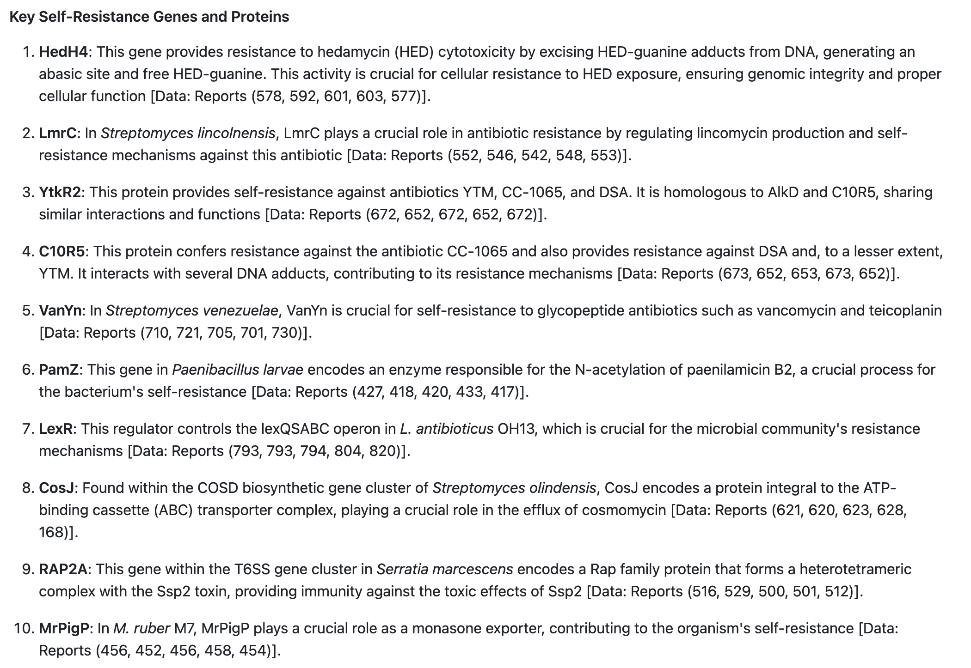
Project Deliverables: GrapRAG +GPT-4o Result
Notes:
And this is the part of the answer from the trained model when we asked “list all the self-resistered genes”

Slide 14
Project Deliverables: GrapRAG +GPT-4o Why?
What is the difference between human literature review and this approach?
Notes:
In this point you may ask “What is the difference between human literature review and this approach?”

Slide 15
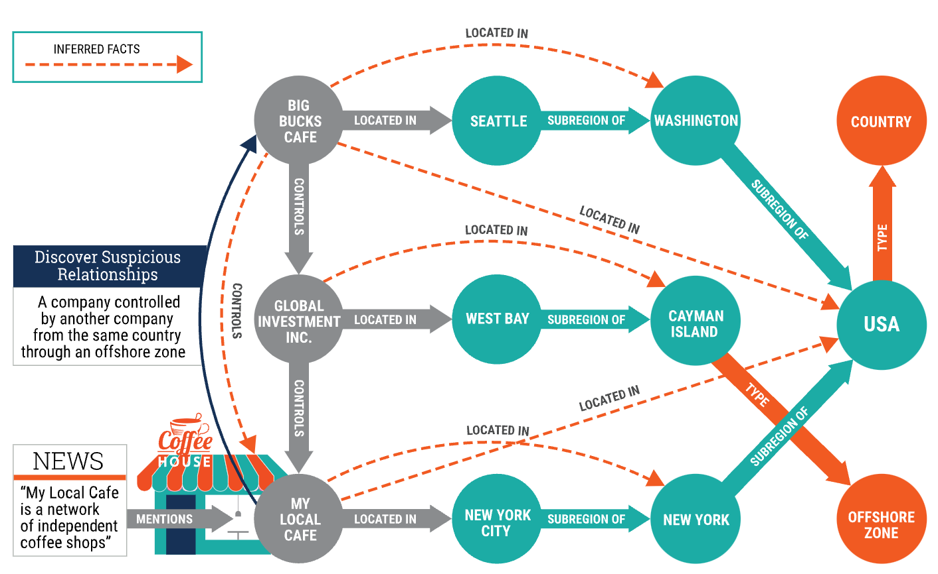
Project Deliverables: GrapRAG +GPT-4o for Knowledge Graph
https://www.ontotext.com/blog/reasoning-with-big-knowledge-graphs/
Notes:
Yes, it’s a valid point. And that’s why we have to look into the graph that graphrag utilized when it provides answer to our questions.
This is an simple knowledge graph example from ontotext. I am not afilliated with them, but their illustration was the far best.
This describes that one hipster guy enjoys his coffee from this local café which is claimed to be a network of independent coffe shops.
However, by investigating its provider companies and their locations via graph, it turns out to be a part of offshore company.

Slide 16
Project Deliverables: GrapRAG +GPT-4o knowledge graph example
HedH4
LexR
SELF-RESISTANCE
https://www.ontotext.com/blog/reasoning-with-big-knowledge-graphs/
Notes:
We can apply this to our use case as well. What we want to do is to identify latent self-resistance genes.
In this example, we don’t know if the gene LexR is a self resistance gene.
However, by insvestigating graphs and looking into relationships between LexR genes and other genes, regulators, compound,
We found out that LexR is a self resistance gene!
The most important thing is that if we have this knowledge graph, computer will do all the inference on behalf of us with fancy graph theories.
So to build this system was my part of the goal

Slide 17
Project Deliverables: ML training datasets from pathogen dataset
Isolate dataset
Downloaded list of all ESKAPE pathogens with complete assemblies
microbiggE dataset
Downloaded list of AMR genes for ESKAPE pathogens
NCBI assembly dataset
Download the ‘protein-fastas’ using the Accessions from Isolate dataset

Slide 18
Genes and genomes for ESKAPE pathogens
microbiggE dataset
~ 3.5 million AMR genes in ~ 250,000 unique genomes
Isolates (filtering on ‘complete assemblies)
8,267 unique genomes
Due to time-crunch:
5 genomes per each species of ESKAPE pathogens

Slide 19
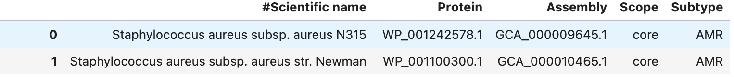
Challenges!
Protein ID in Pathogen Dataset don’t match Protein ID in the downloaded files for each accession!
So, to overcome this, I compared the actual protein sequences between the 2 datasets!

Slide 20
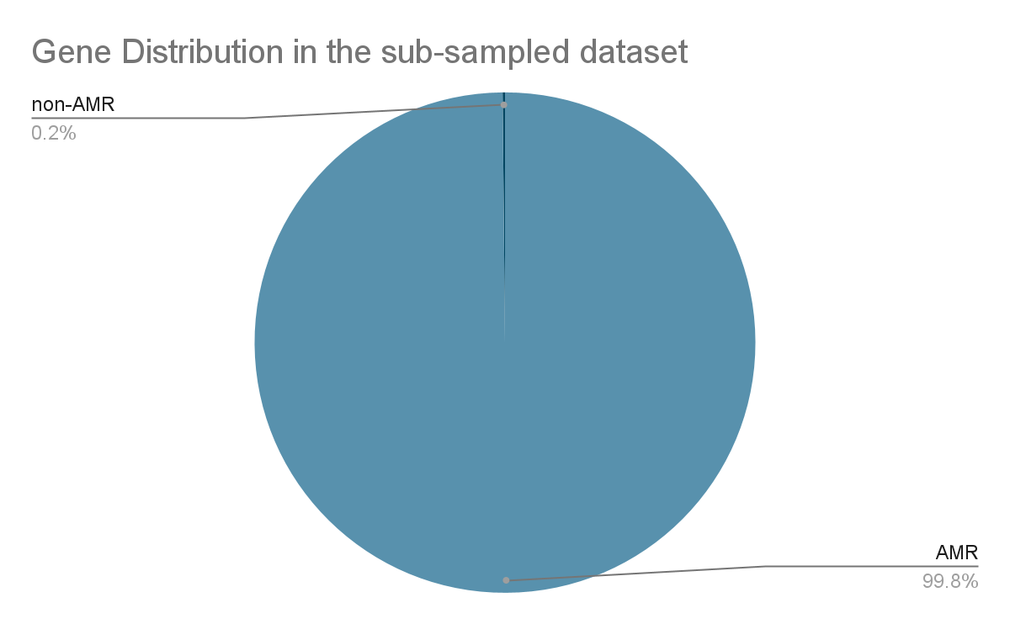
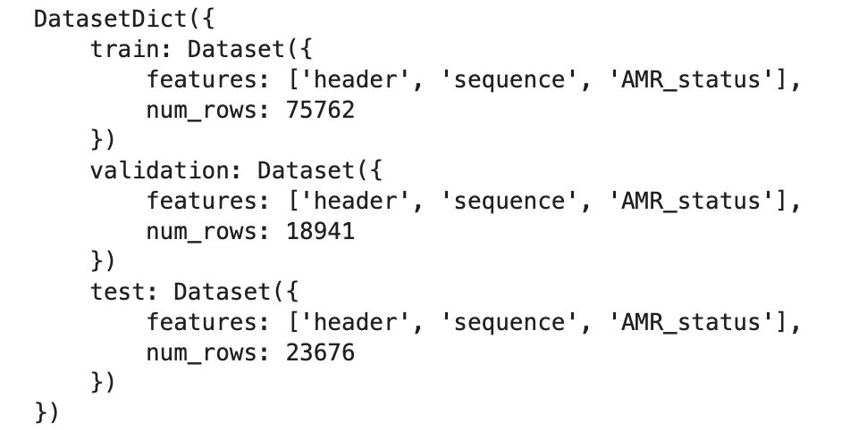
Final training set:
180 AMR genes and 118,199 non-AMR genes
20% test;
80% train out of which 20% validation

Slide 21
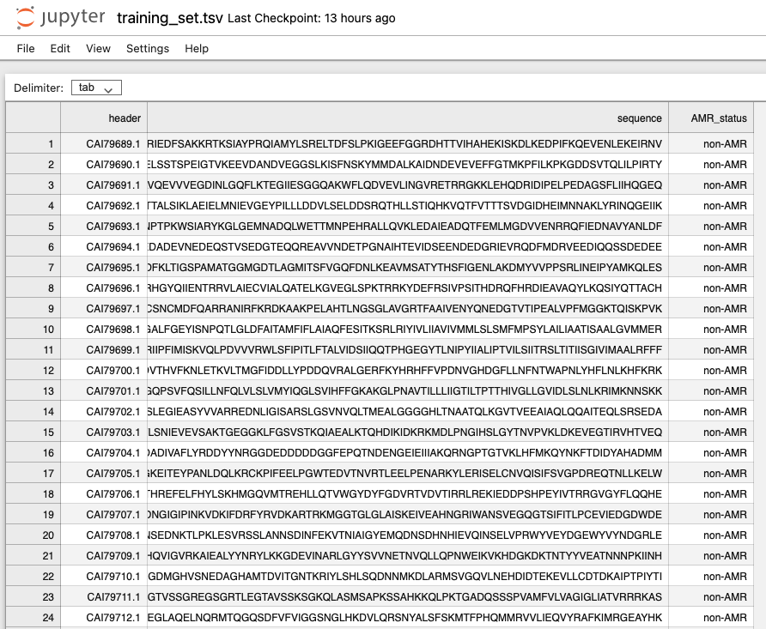
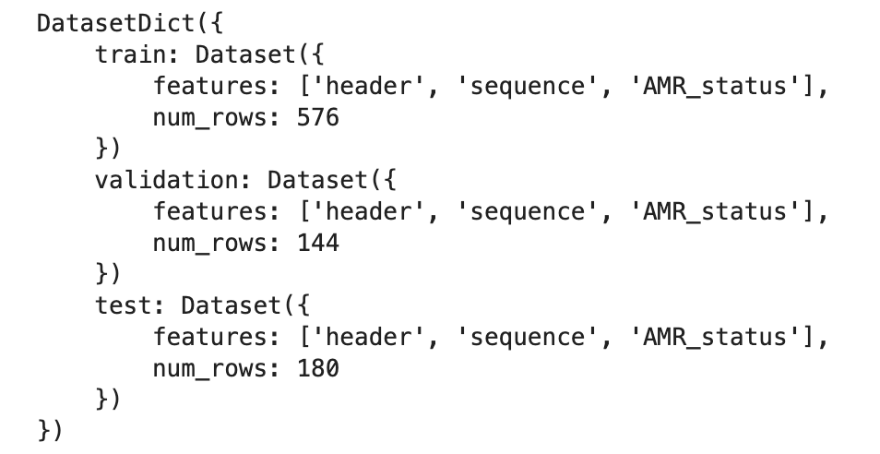
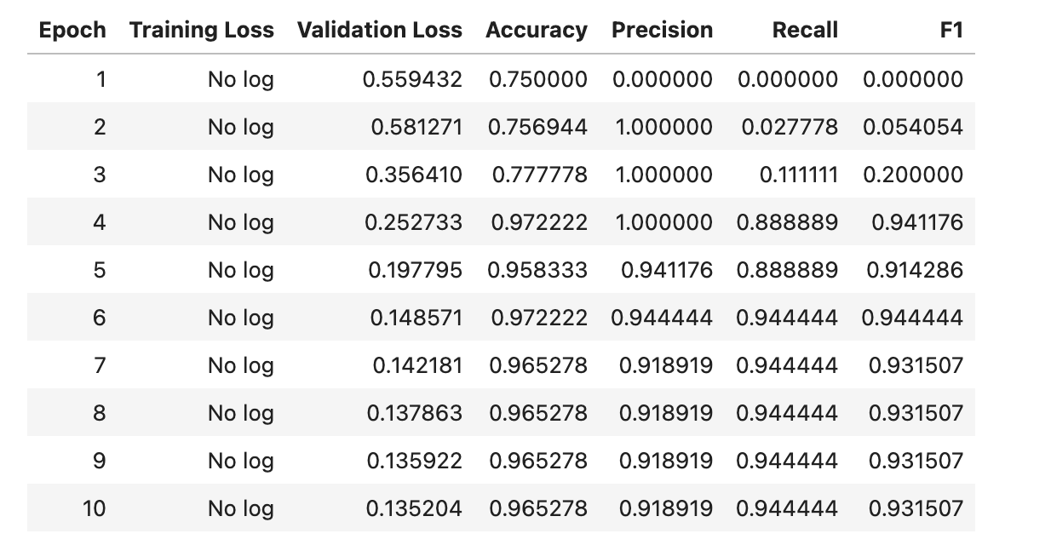
Project Deliverables: Fine-tuned AMR detection transformers Model (Rostlab/prot_bert)
Notes:
Training dataset was 180 AMR protein sequences and 720 non-AMR protein sequences were split into train, valid and test dataset to fine-tune prot_bert from rostlab. Prot_bert https://huggingface.co/Rostlab/prot_bert - a bert model pretrained on a large corpus of protein sequences.

Slide 22






Next Steps: Fine-tuning AMR and SR ML models on microbial sequences
Few-shot prompting with llama-3.1-7B-instruct (task + 5 examples)
EMERALD BGCs pipeline (NER transformers)
Annotated sentences with BGCs entities:
bgc-gene-name
bgc-class
bgc-protein-name
bgc-compound
bgc-action
bgc-accession
bgc-organism
Annotated sentences with self-resistance entities:
Self-resistance-gene-protein
Self-resistance-mechanism
Self-resistance-compound
Self-resistance-regulator
Organism
Accession
Self-resistance gene related literature (150 abstracts / 50 OA full texts)
Identifying LLM-derived SR protein translations in whole genome sequences to generate training datasets for fine-tuning SR ML models

Slide 23
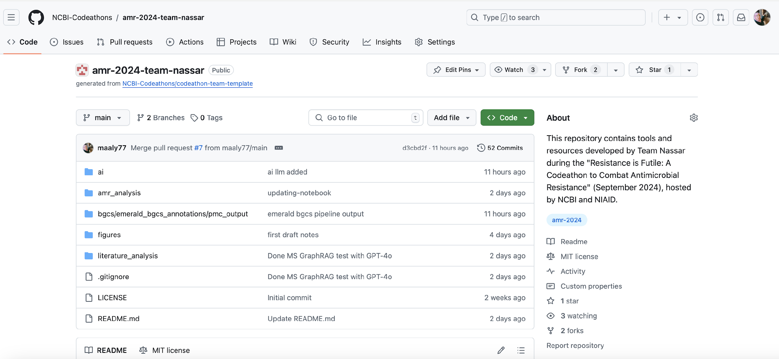
Deliverables: LLM-derived dataset, scripts and pathogen training datasets
https://github.com/NCBI-Codeathons/amr-2024-team-nassar
AWESOME JOB MY AMAZING TEAM :)

